Slide 1
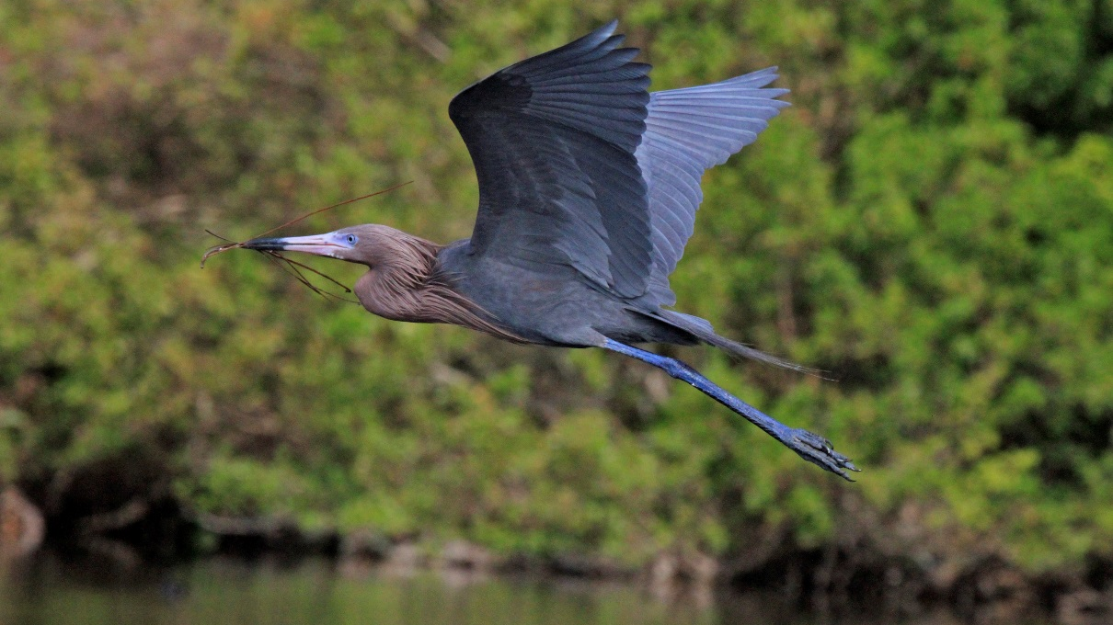
FWC’s wading bird surveys
Photo by Ann Macias

Slide 2
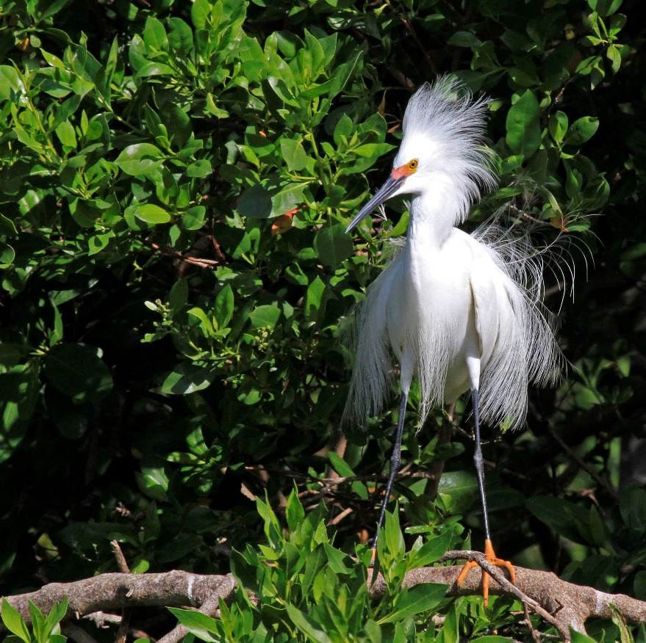
Why do we conduct surveys?
Finger on the pulse of important colonies
Understand the distribution of imperiled species
Prioritize restoration efforts at regional and statewide levels
Inform FWC’s permitting guidelines
Assist our federal and flyway partners
Photo by Ann Macias

Slide 3
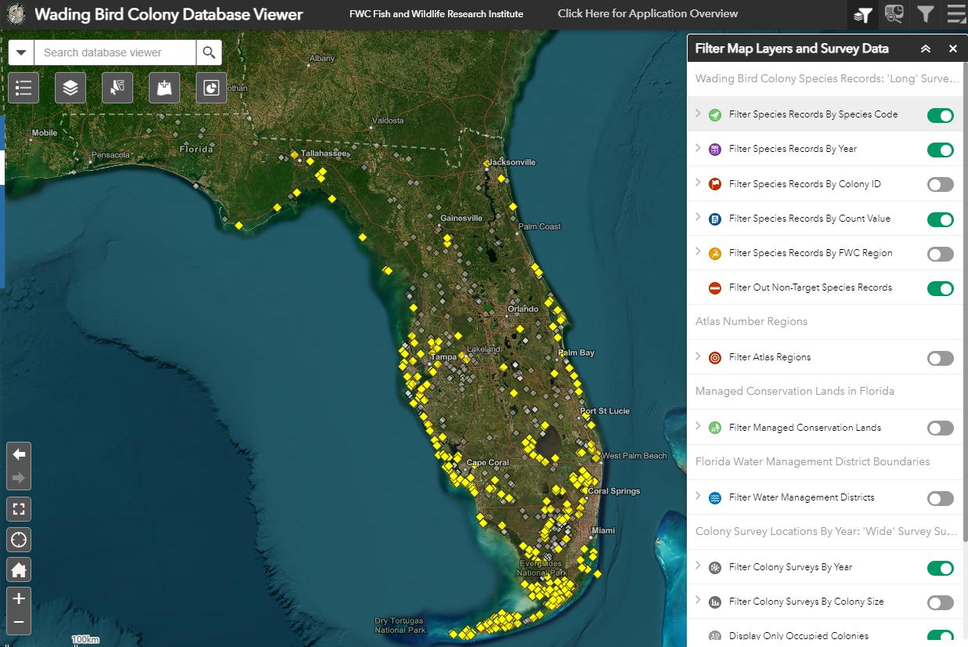
FWC’s new wading bird database
Completed in April 2022
FWC staff and other professional biologists are to contribute data annually
To date, we have not sought or accepted data from volunteers.
Unlike the Florida Shorebird Database, there are no staff dedicated to its operation or to QA/QC.

Slide 4
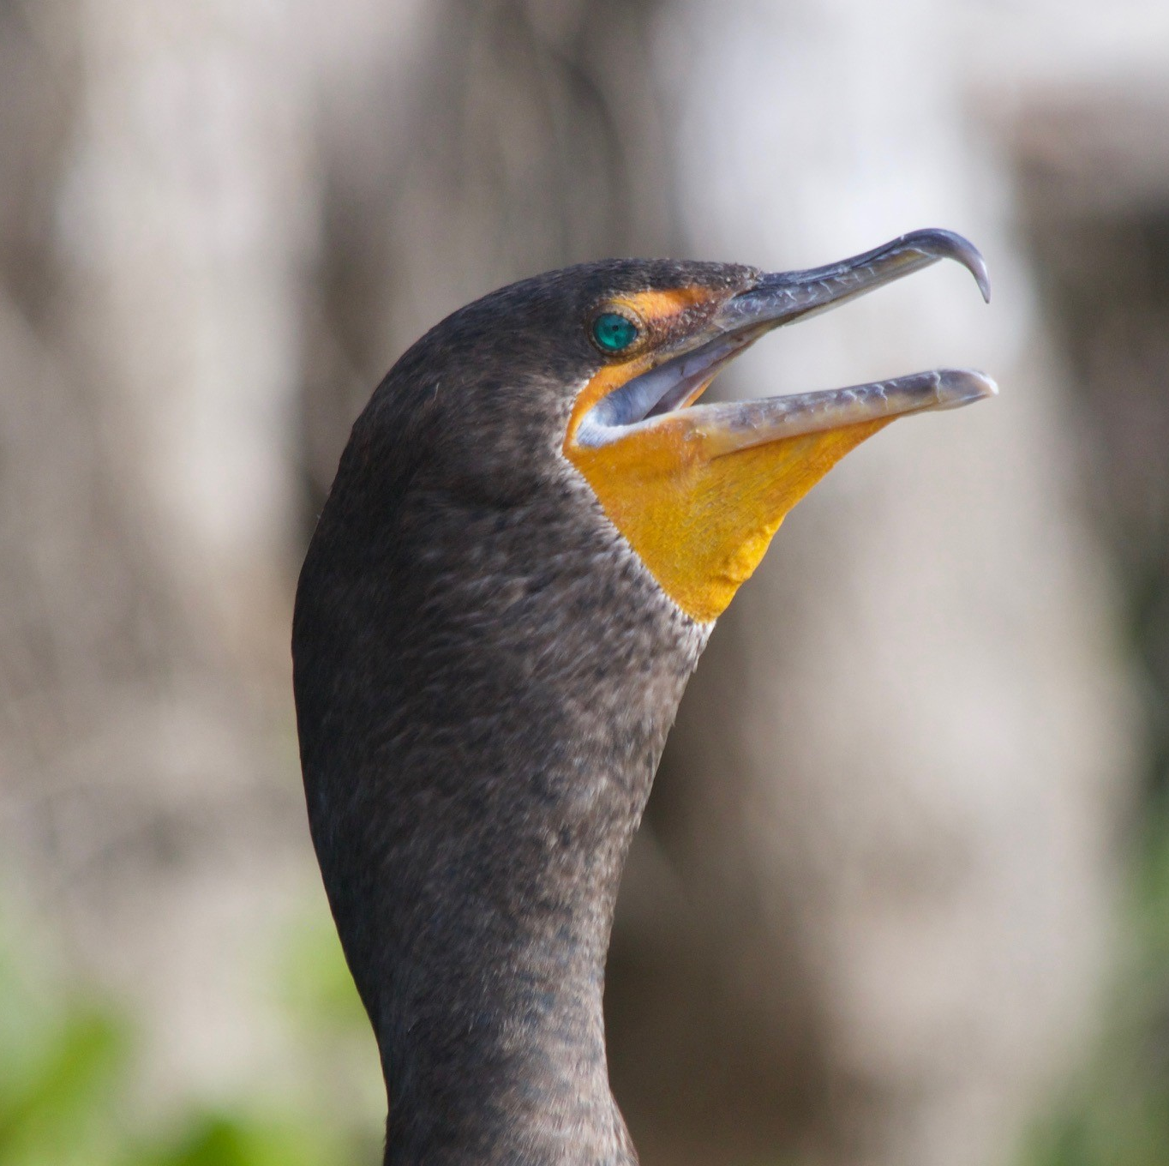
We want your help in 2024
The U.S. Fish and Wildlife Service is coordinating a 2024 wading bird survey throughout the Atlantic Flyway.
Of special interest is double-crested cormorant surveys
We will be soliciting colony location info from the public.
FWC is co-leading a statewide reddish egret survey in 2024.

Slide 5
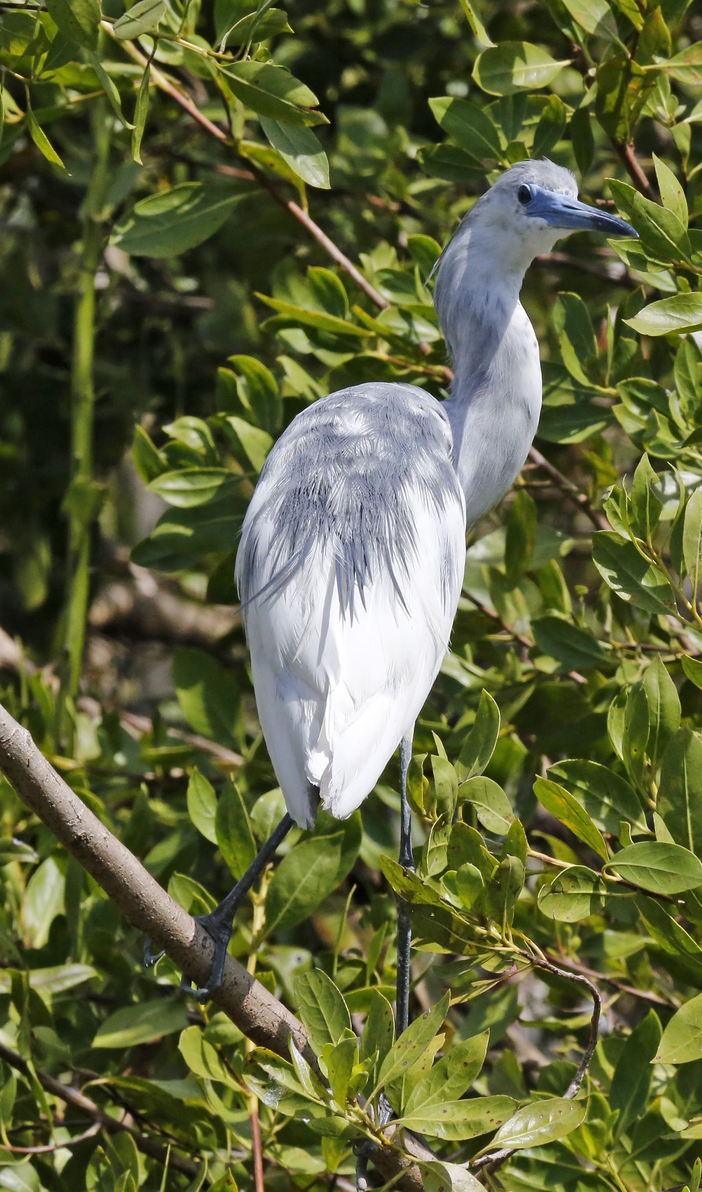
What might the help in 2024 look like?
Reporting the existence of a colony.
Reporting the species composition of a colony.
Surveying a colony.
Photo by Ann Macias

Slide 6
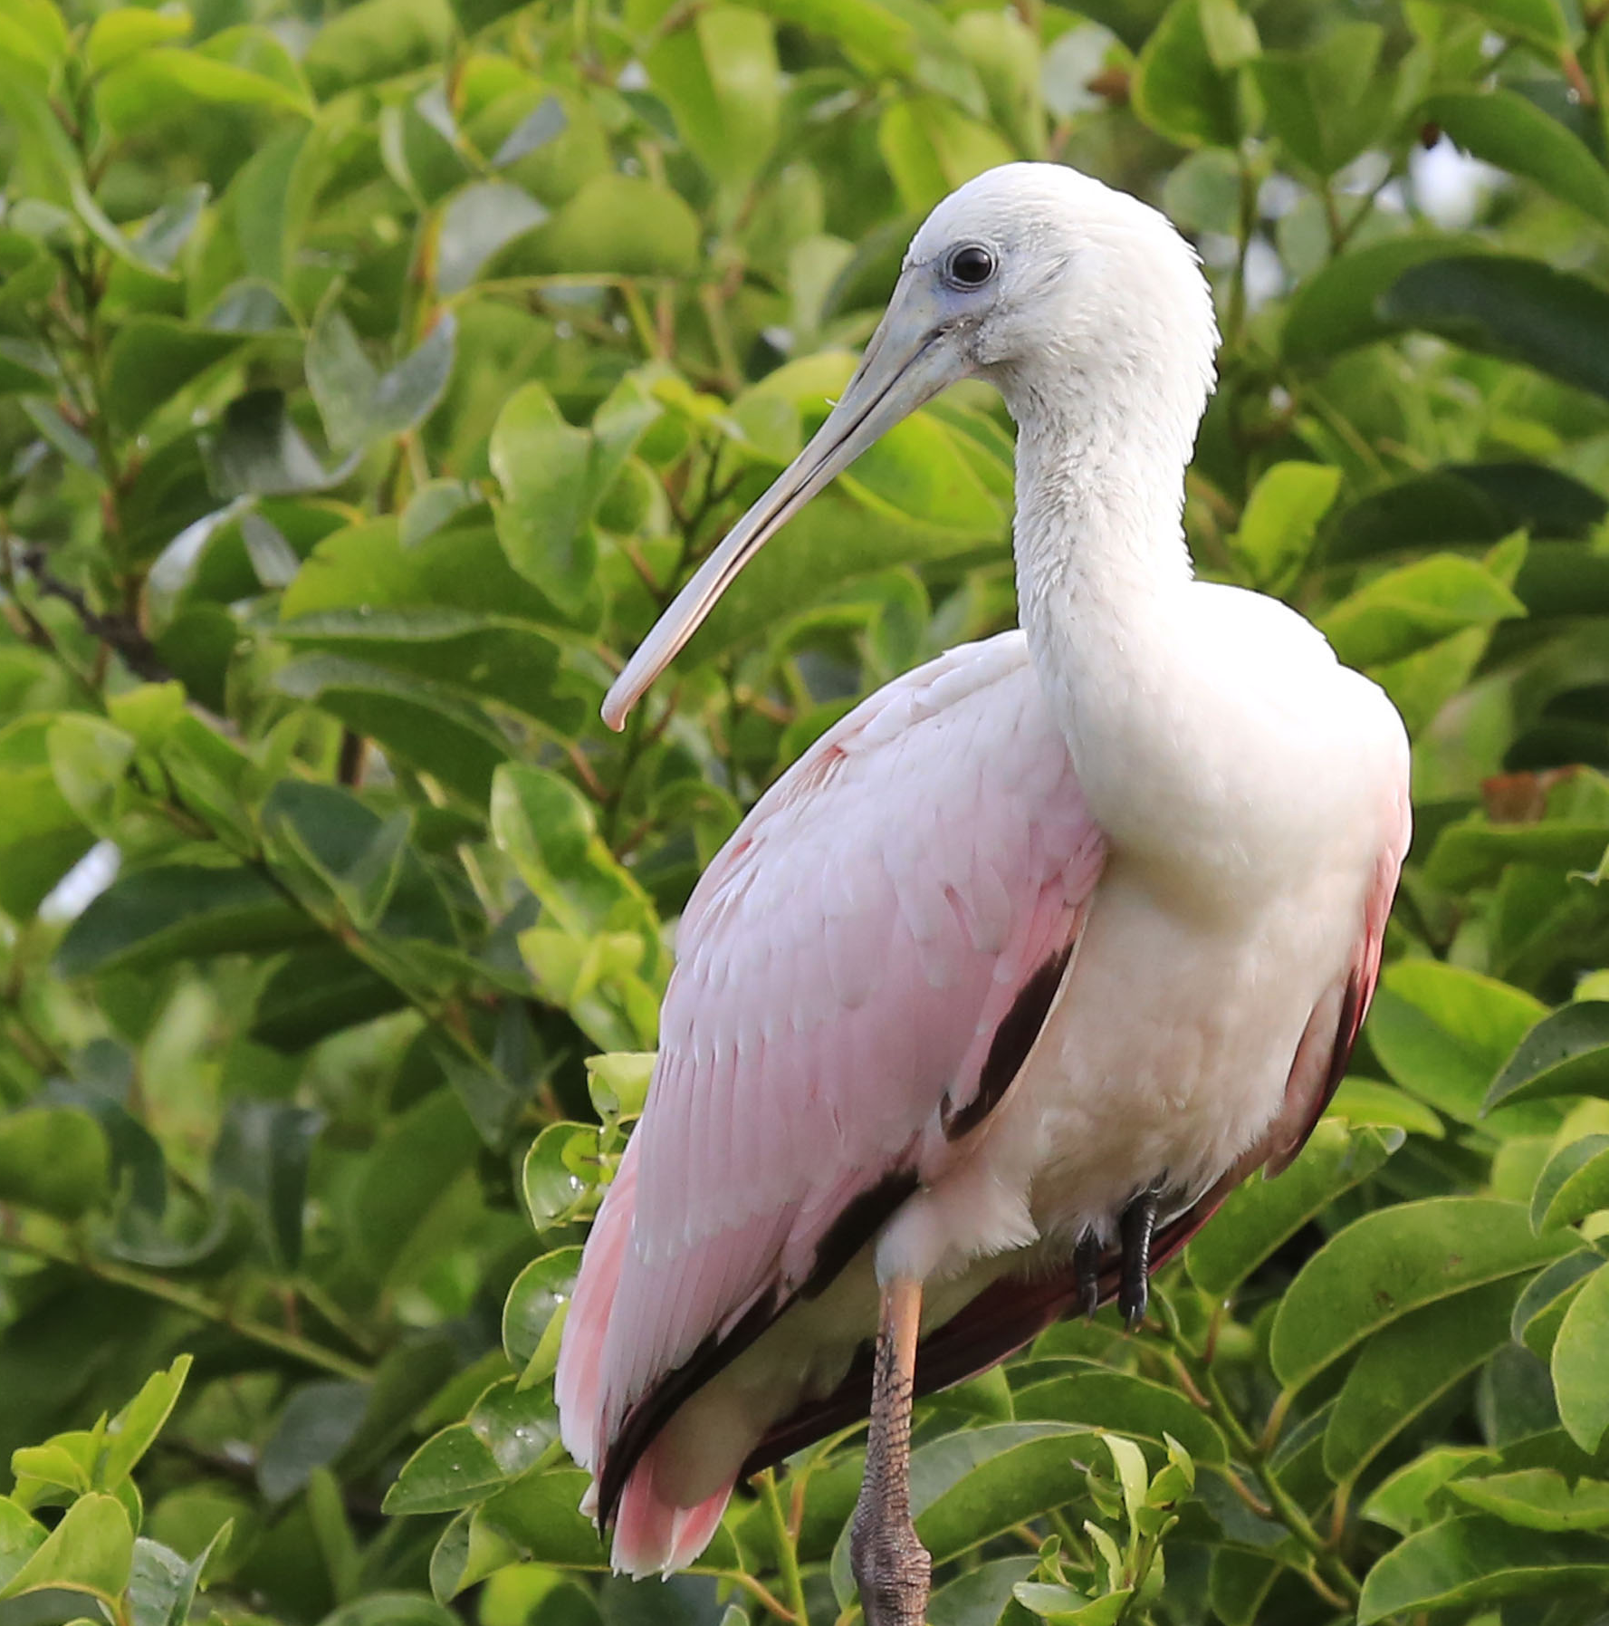
So what do we want to do in 2023?
Conduct a trial run of
FWC’s survey protocols
FWC’s datasheets
FWC’s web-based data submission forms
Coordination with land managers
Photo by Ann Macias

Slide 7
Words of caution for 2023
We are really glad Audubon reached out, but we have substantial capacity issues.
2023 is a pilot year, and the effort should be modest.
Photo by Ann Macias

Slide 8
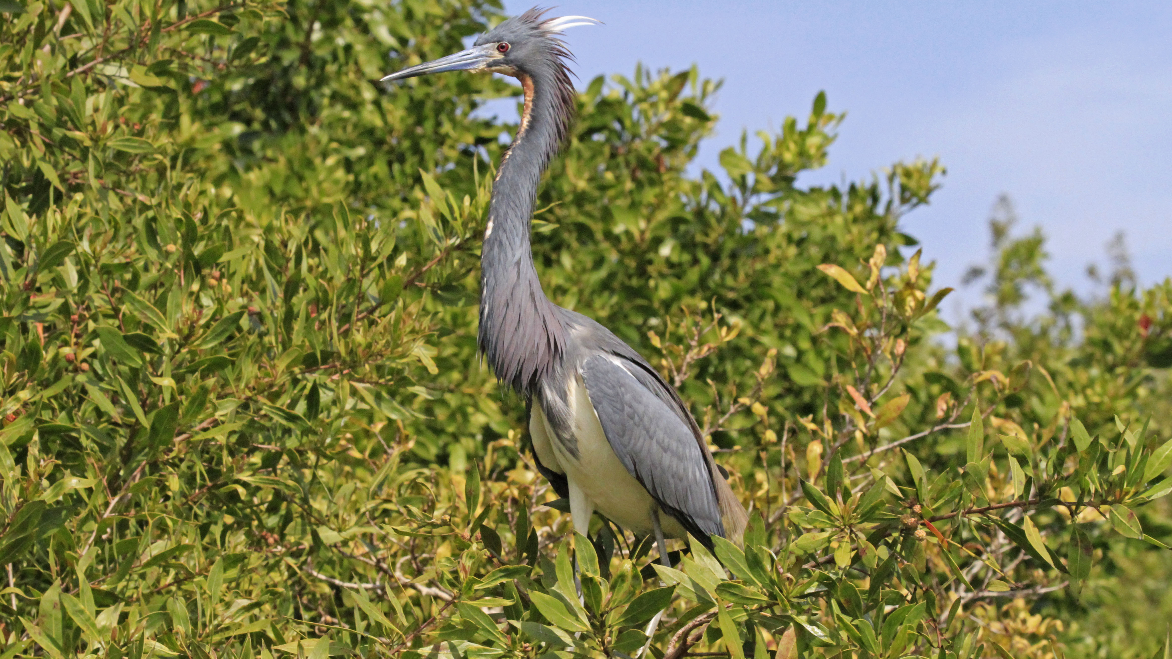
FWC’s survey protocols
Photo by Ann Macias

Slide 9
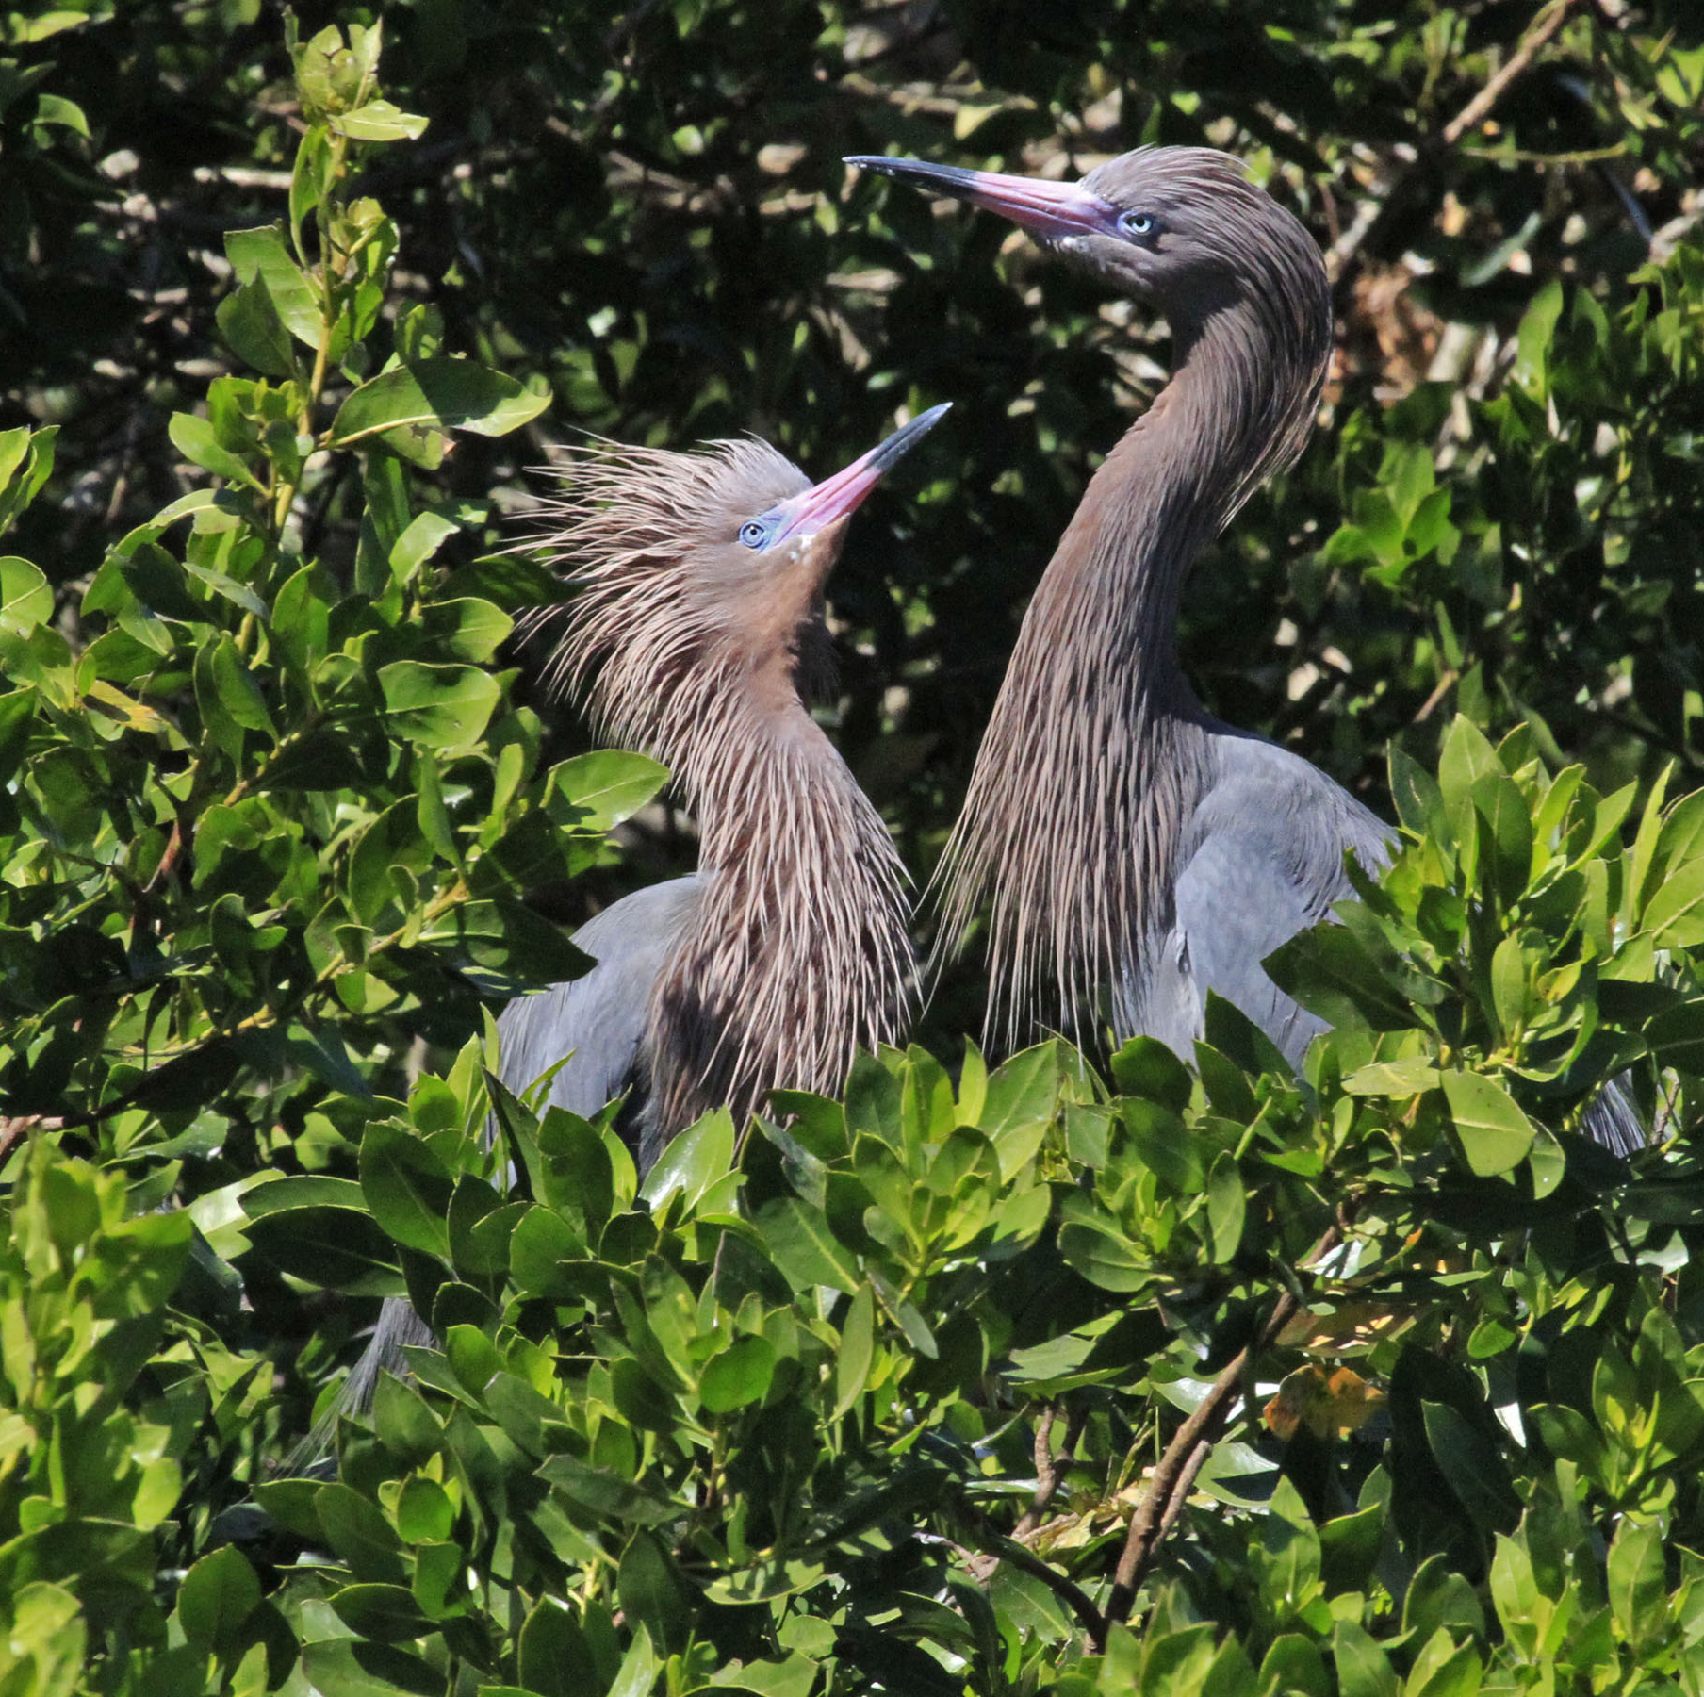
Preface: counting nesting wading birds is hard!
Our 2016 statewide estimate of reddish egrets was 480 pairs (95% CI: 375-606).
Sources of uncertainty:
Observers
Seasonal phenology
Daily variation in bird activity

Slide 10
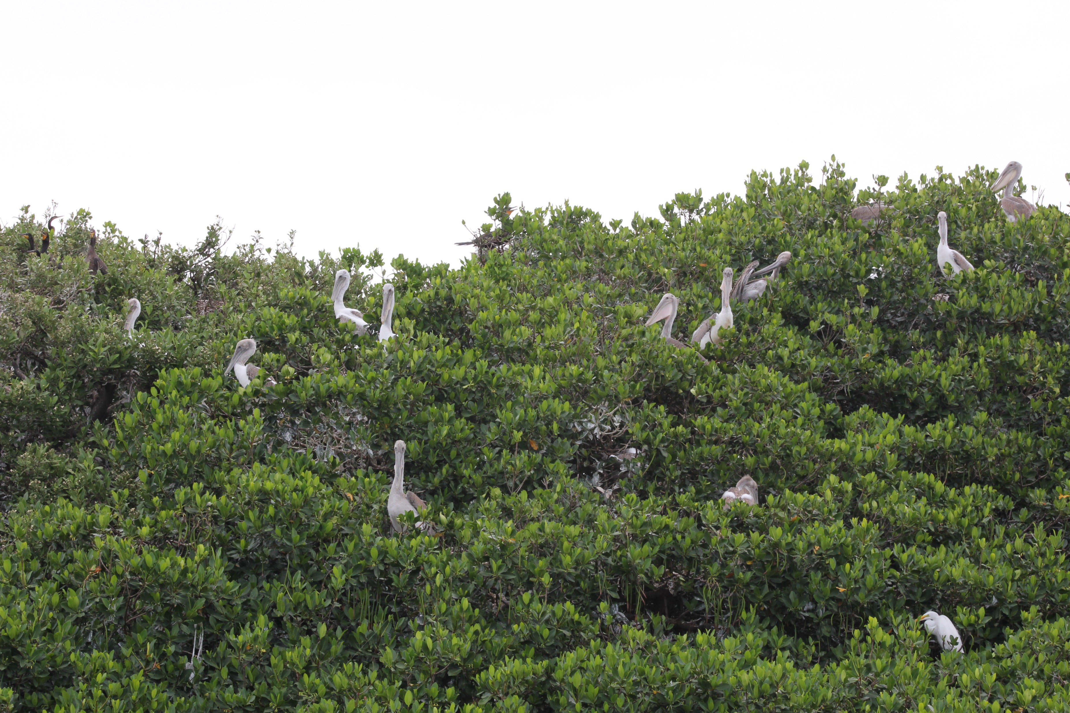
Direct counts
Can be performed by a single person
Appropriate for small colonies where most or all nests can be observed.
Simple tally of nesting pairs or nests based on direct observation from a safe distance.

Slide 11
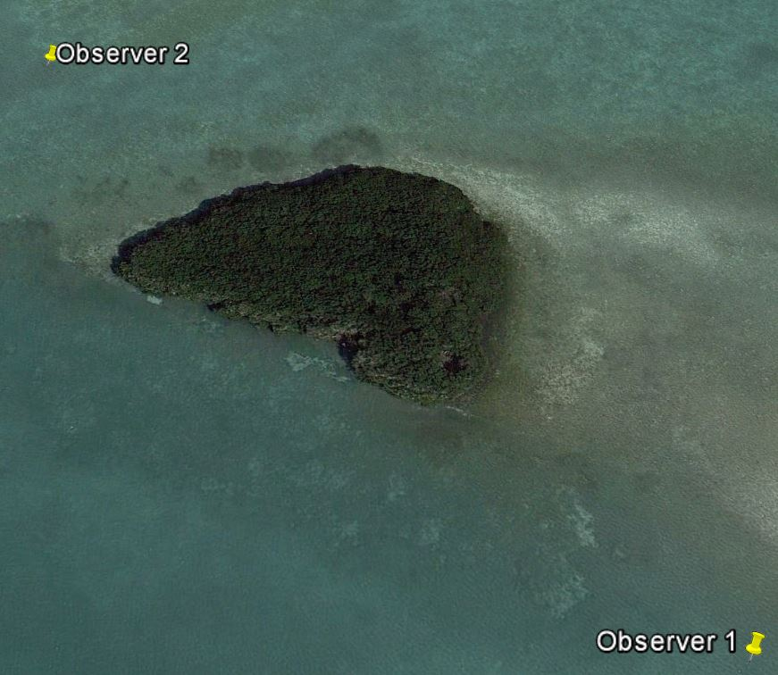
Flight line surveys (which can be a challenge!)
Requires 2+ people.
Must occur in early morning and during late incubation/early nestling periods.
Used when a site is too large, or species too concealed, to conduct a direct count.
Counts all incoming and outgoing birds.
Can be overwhelming at large/speciose colonies.

Slide 12
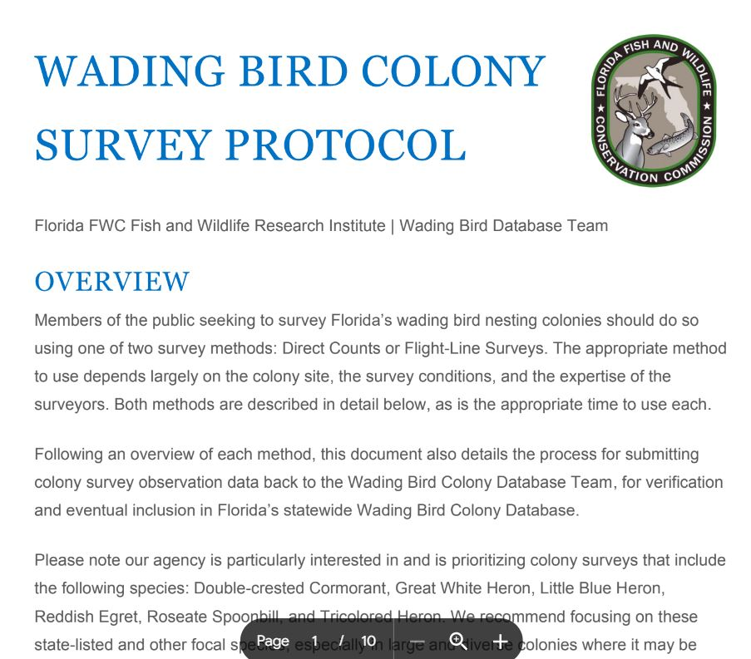
FWC resources for Audubon volunteers
Written protocols for both survey methods
Adapted from our internal protocols specifically for you.
Let us know where/how they lack clarity to improve them for 2024.

Slide 13
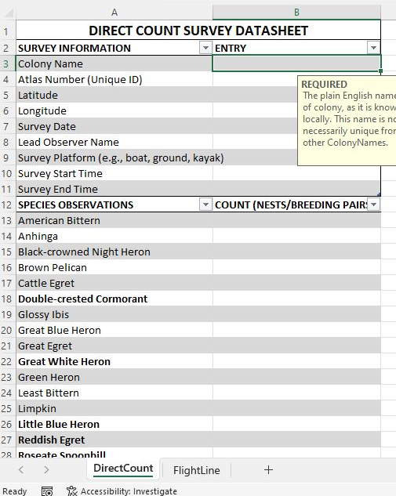
FWC resources for Audubon volunteers
Data entry spreadsheets
These are formatted to be compatible with our database.
We recognize that not everyone will have Microsoft Excel.

Slide 14
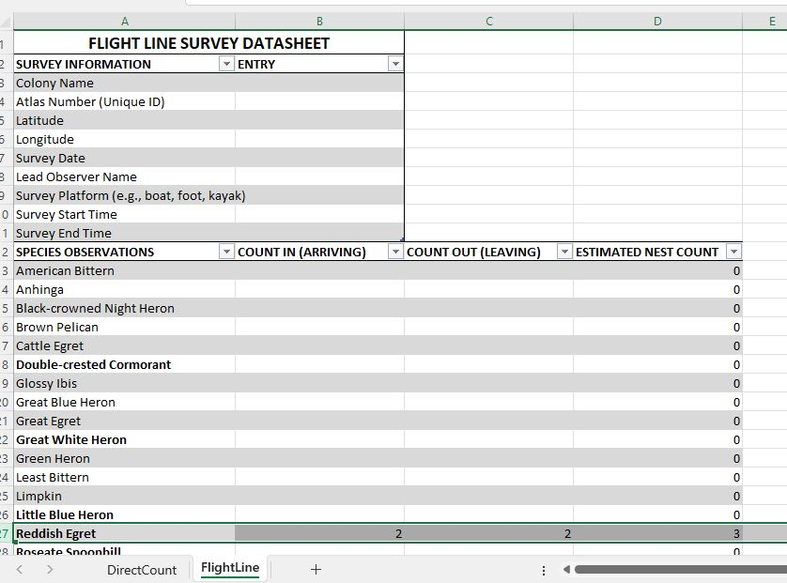
FWC resources for Audubon volunteers
Data entry spreadsheets
These are formatted to be compatible with our database.
We recognize that not everyone will have Microsoft Excel.

Slide 15
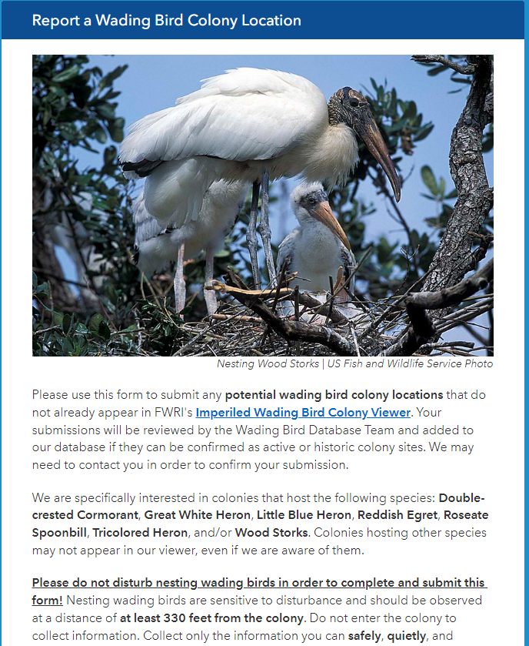
FWC resources for Audubon volunteers
2 websites to submit data to us:
Report a colony

Slide 16
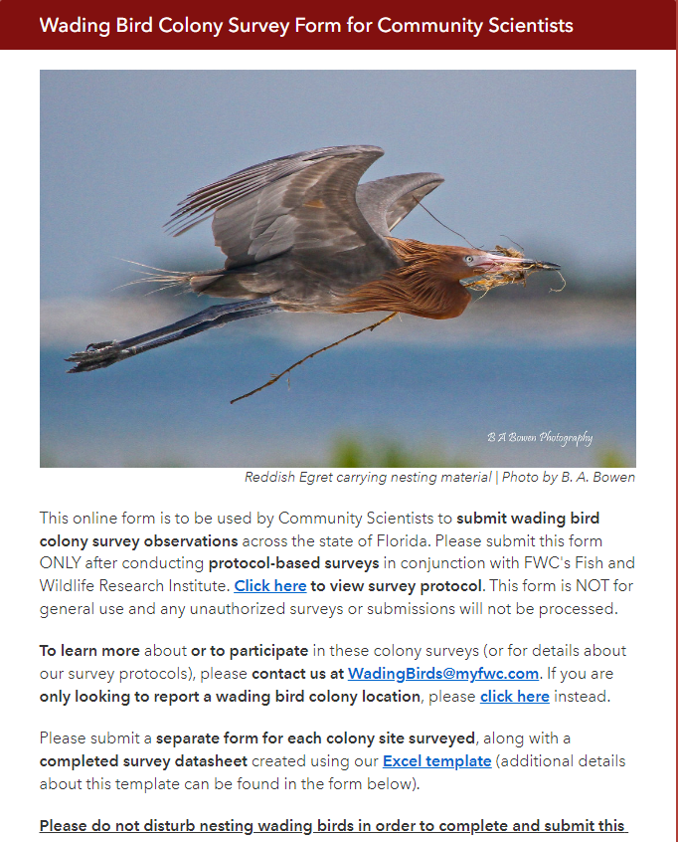
FWC resources for Audubon volunteers
2 websites to submit data to us:
Report a colony
Submit survey data
Close out the request for log-in information.

Slide 17
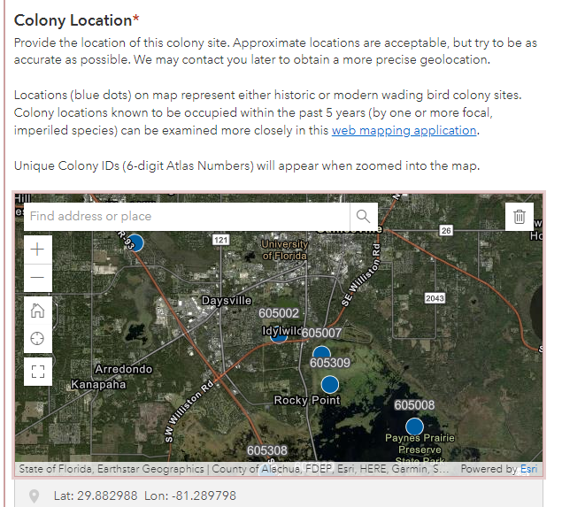
FWC resources for Audubon volunteers
2 websites to submit data to us:
Report a colony
Submit survey data
Both sites have a map of existing colony data

Slide 18
FWC resources for Audubon volunteers
2 websites to submit data to us:
Report a colony
Submit survey data
Both sites have a map of existing colony data
Neither site has been tested by external users

